Slide 1
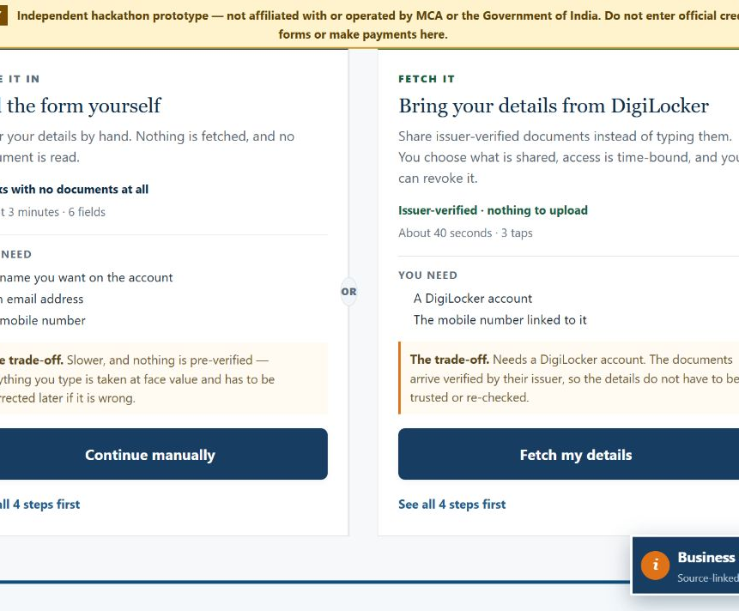
MCA PORTAL TRAINING
Register a company
with a clear route
A guided training deck for first-time founders and registrars — from account preparation to post-incorporation actions.
This is an independent training prototype. It does not file a form, make a payment or replace the authorised MCA portal.
Training edition · August 2026
Notes:
Use this deck alongside the interactive prototype.
Source: Business Facilitation Portal synthetic simulation.
[Sources]
Source: Business Facilitation Portal synthetic simulation.
[/Sources]

Slide 2
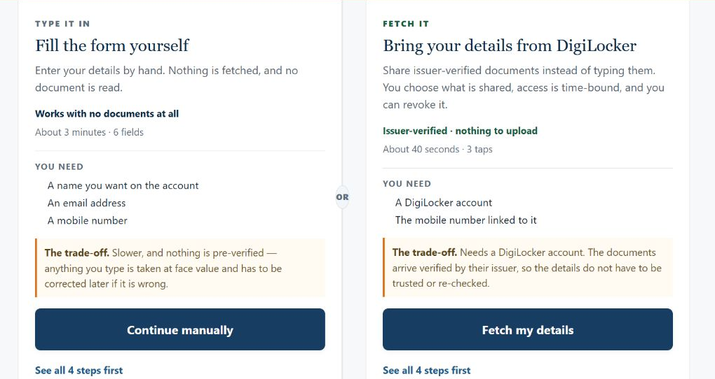
STEP 0 · CHOOSE YOUR ROUTE
02
One account, two ways to prepare it
The route changes how details are entered — not the statutory outcome.
Choose according to where the details come from.
Type them when no verified document account is available.
Use the assisted route when the holder wants to share selected issuer records.
Both routes open the same workspace.
TRAINING MATERIAL · REPRESENTATION ONLY · VERIFY LIVE REQUIREMENTS ON MCA
Business Facilitation Portal
Notes:
Explain that the assisted route is a simulation, not a production integration.
https://www.digilocker.gov.in/web/partners/requesters
Source: Business Facilitation Portal synthetic simulation.
[Sources]
https://www.digilocker.gov.in/web/partners/requesters
Source: Business Facilitation Portal synthetic simulation.
[/Sources]

Slide 3
BEFORE LOGIN
03
Prepare the people, address and proposed activity
Good preparation prevents most avoidable pauses during incorporation.
1
2
3
Promoters and directors
Registered office
Proposed business
Names, identity/address proofs, email and mobile details; proposed subscribers and directors.
Address proof, recent utility bill and owner’s no-objection document where applicable.
Plain-language objects, suitable NIC activity codes, company class/category and proposed capital.
Keep a versioned folder
Use clear file names, confirm spelling across every record, and have the responsible professional review the final statutory package.
TRAINING MATERIAL · REPRESENTATION ONLY · VERIFY LIVE REQUIREMENTS ON MCA
Business Facilitation Portal
Notes:
Document requirements vary by company type and facts. Use the official checklist current on the filing date.
https://www.mca.gov.in/content/dam/mca/pdf/SPICEplus-and-linked-filings-FAQs-V3-20230122.pdf
[Sources]
https://www.mca.gov.in/content/dam/mca/pdf/SPICEplus-and-linked-filings-FAQs-V3-20230122.pdf
[/Sources]

Slide 4
STEP 1 · ACCESS
04
Create the MCA account and prepare digital signatures
SPICe+ is a post-login service; signatories who affix DSC need the appropriate business-user role.
1
Create or verify the MCA user account
Use the applicant’s controlled email and mobile. Confirm access before starting the webform.
CONTROL CHECK
Who does what?
2
Register or upgrade the user role
Applicant
Provides accurate facts and approves the filing
The responsible signatories must be able to associate and use their Digital Signature Certificates.
Director / subscriber
Reviews and signs the relevant documents
Test the DSC environment early
Professional
Certifies where the law or form requires it
3
Certificate validity, name matching and signer mapping should be checked before final submission.
Registrar of Companies
Examines the filing and communicates the outcome
TRAINING MATERIAL · REPRESENTATION ONLY · VERIFY LIVE REQUIREMENTS ON MCA
Business Facilitation Portal
Notes:
Do not promise eligibility or approval. Confirm the current role-registration and DSC instructions on MCA.
https://www.mca.gov.in/content/dam/mca/pdf/SPICEplus-and-linked-filings-FAQs-V3-20230122.pdf
[Sources]
https://www.mca.gov.in/content/dam/mca/pdf/SPICEplus-and-linked-filings-FAQs-V3-20230122.pdf
[/Sources]

Slide 5
STEP 2 · SPICE+ PART A
05
Reserve a name that matches the proposed activity
Part A captures the company profile, activity codes and proposed name.
01
02
03
04
Define activity
Select NIC codes
Search conflicts
Run auto-check
→
→
→
Write the main activity in plain language.
Choose activity codes that match the objects.
Check existing companies/LLPs and relevant trademarks.
Resolve restrictions and attach support where required.
BEFORE SUBMITTING
Phonetic resemblance, protected words, trademark conflicts, an incorrect category, or activity codes inconsistent with the objects can lead to objections.
Similarity matters beyond exact spelling
TRAINING MATERIAL · REPRESENTATION ONLY · VERIFY LIVE REQUIREMENTS ON MCA
Business Facilitation Portal
Notes:
Part A may be filed separately or with Part B. Verify name rules and current search tools.
https://www.mca.gov.in/Ministry/pdf/SpicePlusFAQS_12032021.pdf
https://www.mca.gov.in/content/dam/mca/pdf/SPICEplus-and-linked-filings-FAQs-V3-20230122.pdf
[Sources]
https://www.mca.gov.in/Ministry/pdf/SpicePlusFAQS_12032021.pdf
https://www.mca.gov.in/content/dam/mca/pdf/SPICEplus-and-linked-filings-FAQs-V3-20230122.pdf
[/Sources]

Slide 6
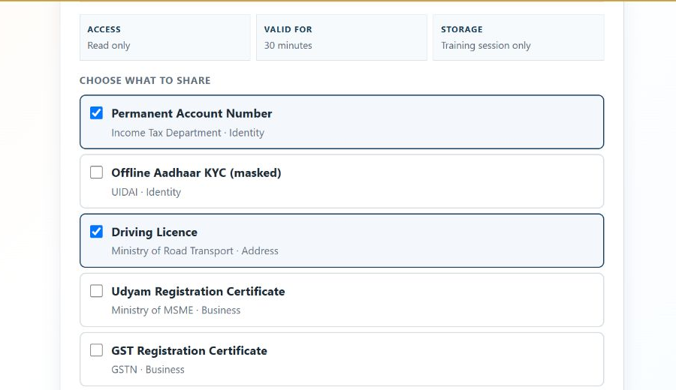
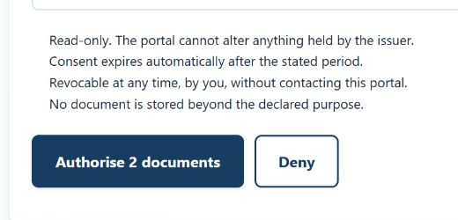
OPTIONAL ASSISTED ROUTE
06
Consent must show scope before authorisation
The holder sees the access period, chooses individual documents and approves an exact count.
The decision remains with the document holder.
Access conditions appear before consent. Selected and unselected records stay visible together, so the scope can be reviewed without opening another screen.
The action itself states the exact document count.
TRAINING MATERIAL · REPRESENTATION ONLY · VERIFY LIVE REQUIREMENTS ON MCA
Business Facilitation Portal
Notes:
Demonstrate the scope-selection screen and exact authorisation action. The prototype does not connect to DigiLocker or API Setu.
https://www.digilocker.gov.in/web/partners/requesters
https://www.digilocker.gov.in/web/security-architecture
Source: Business Facilitation Portal synthetic simulation.
[Sources]
https://www.digilocker.gov.in/web/partners/requesters
https://www.digilocker.gov.in/web/security-architecture
Source: Business Facilitation Portal synthetic simulation.
[/Sources]

Slide 7
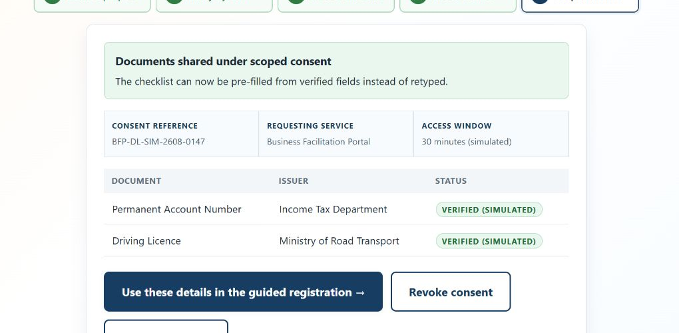
OPTIONAL ASSISTED ROUTE
07
A consent receipt makes access visible and reversible
After authorisation, the holder can see what was shared, for how long, and where to revoke it.
Everything needed to understand the consent remains on one screen.
The request reference, access window, document issuers and verification status remain visible. Revocation sits beside the continuation action.
Training simulation only
TRAINING MATERIAL · REPRESENTATION ONLY · VERIFY LIVE REQUIREMENTS ON MCA
Business Facilitation Portal
Notes:
Use the receipt to explain traceability, time-bound access and revocation.
https://www.digilocker.gov.in/web/partners/requesters
Source: Business Facilitation Portal synthetic simulation.
[Sources]
https://www.digilocker.gov.in/web/partners/requesters
Source: Business Facilitation Portal synthetic simulation.
[/Sources]

Slide 8
STEP 3 · SPICE+ PART B
08
Complete incorporation and the linked forms as one package
Part B captures incorporation details and is filed with the applicable linked forms.
01
02
03
SPICe+ Part B
Constitution
Linked services
✓
Company and registered-office details
✓
eMoA — memorandum and objects
✓
AGILE-PRO-S and applicable registrations
✓
Capital and subscriber/director information
✓
eAoA — internal governance rules
✓
Bank-account request in the integrated route
✓
DIN, PAN/TAN and other integrated services
✓
INC-9 and declarations where applicable
✓
State-specific items where offered
Draft → review → submit webforms → download PDFs → affix DSC → upload signed PDFs → pay applicable fees
TRAINING MATERIAL · REPRESENTATION ONLY · VERIFY LIVE REQUIREMENTS ON MCA
Business Facilitation Portal
Notes:
The precise linked-form set depends on the company and applicant facts. Follow the current MCA sequence.
https://www.mca.gov.in/Ministry/pdf/SPICe%2Band_linked_filings_FAQs_V3_13%20Jan_2022_updated.pdf
[Sources]
https://www.mca.gov.in/Ministry/pdf/SPICe%2Band_linked_filings_FAQs_V3_13%20Jan_2022_updated.pdf
[/Sources]

Slide 9
STEP 4 · SUBMIT AND TRACK
09
Treat signing, upload and payment as separate control points
A clean draft is not yet a filed application. Confirm every transition on the authorised portal.
1
2
3
4
5
Review
Submit webforms
Affix DSC
Upload
Pay and track
Validate names, addresses, attachments and declarations.
Generate the filing package and preserve the service request number.
Each required signatory signs the correct downloaded PDF.
Return the signed package within the applicable validity window.
Use the official payment path and monitor status or resubmission.
EVIDENCE TO KEEP
Draft versions · consent/approvals · signed PDFs · SRN · challan/payment receipt · RoC communication · certificate of incorporation
Never rely on a browser tab as the only record of a statutory submission.
TRAINING MATERIAL · REPRESENTATION ONLY · VERIFY LIVE REQUIREMENTS ON MCA
Business Facilitation Portal
Notes:
Explain the difference between submitted, signed, uploaded, paid and approved. Avoid promising processing times.
https://www.mca.gov.in/Ministry/pdf/SPICe%2Band_linked_filings_FAQs_V3_13%20Jan_2022_updated.pdf
[Sources]
https://www.mca.gov.in/Ministry/pdf/SPICe%2Band_linked_filings_FAQs_V3_13%20Jan_2022_updated.pdf
[/Sources]

Slide 10
AFTER APPROVAL
10
The certificate starts the operating and compliance journey
Incorporation is not the end of the workflow. Establish ownership, banking, records and recurring responsibility.
IMMEDIATE
Read the certificate and master data
Check the legal name, CIN, date, registered office and authorised/subscribed capital.
NEXT
Activate operations responsibly
Complete bank-account steps, subscriptions, registers and any commencement requirement that applies.
ONGOING
Create a compliance calendar
Board/annual actions, tax and labour obligations, licences, beneficial ownership and event-based filings.
Entity type, state, sector and events change the checklist — keep the portal source-linked and date-stamped.
TRAINING MATERIAL · REPRESENTATION ONLY · VERIFY LIVE REQUIREMENTS ON MCA
Business Facilitation Portal
Notes:
This slide is a control framework, not a complete legal checklist. Link users to current official obligations by entity, state and sector.
https://www.mca.gov.in/content/mca/global/en/home.html
[Sources]
https://www.mca.gov.in/content/mca/global/en/home.html
[/Sources]

Slide 11
TRAINING RECAP
11
A beginner-friendly gateway still keeps the legal boundary clear
Guide, prepare and explain in plain language — but preserve consent, human responsibility and official submission.
✓
Choose the manual or consent-assisted preparation route
✓
Complete Part B and all applicable linked forms
✓
Prepare people, address, activity and proposed name
✓
Review, sign, upload, pay and retain evidence
✓
Use SPICe+ Part A for the name and profile
✓
Move into post-incorporation and recurring compliance
Continue practising in the interactive prototype
Always verify the live service, fee and form requirements on mca.gov.in before filing.
/signup · /signup/digilocker · /ease-of-doing-business?route=register-company
TRAINING MATERIAL · REPRESENTATION ONLY · VERIFY LIVE REQUIREMENTS ON MCA
Business Facilitation Portal
Notes:
End with the boundary: training and preparation happen here; statutory submission remains with the competent authority.
https://www.mca.gov.in/content/mca/global/en/home.html
https://www.digilocker.gov.in/web/partners/requesters
Source: Business Facilitation Portal synthetic simulation.
[Sources]
https://www.mca.gov.in/content/mca/global/en/home.html
https://www.digilocker.gov.in/web/partners/requesters
Source: Business Facilitation Portal synthetic simulation.
[/Sources]

